Slide 1
Happiness & Government
The Impact of Democracy & Corruption
2023 Hackathon
Aaron, Ashley, Jesse

Slide 2
01
The Research Process

Slide 3
Research Question:
How does political agency vs corruption impact happiness?

Slide 4
The data
Datasets used:
World Happiness Report
Democracy Rating Index
Source: Wikipedia
Age of Government as a Metric of Political Stability
Source: Wikipedia
We combined each dataset to obtain information on a total of 135 countries

Slide 5
02
Data Visualization

Slide 6
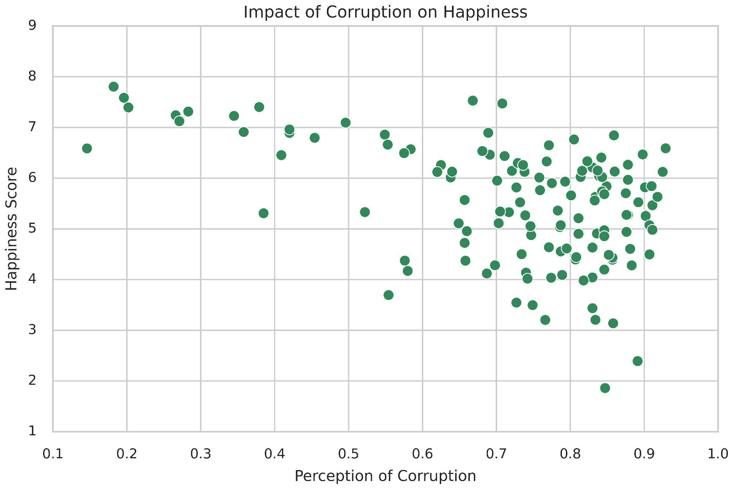
Corruption - a flawed predictor
Loose correlation between happiness and corruption
Dissolves at high levels of corruption
Many outliers:
Iceland & Israel - high happiness, high corruption
Hong Kong - low happiness, low corruption
Romania/Singapore - similar happiness, very different corruption levels
Many factors impact perceptions of corruption
Propaganda, political stability

Slide 7
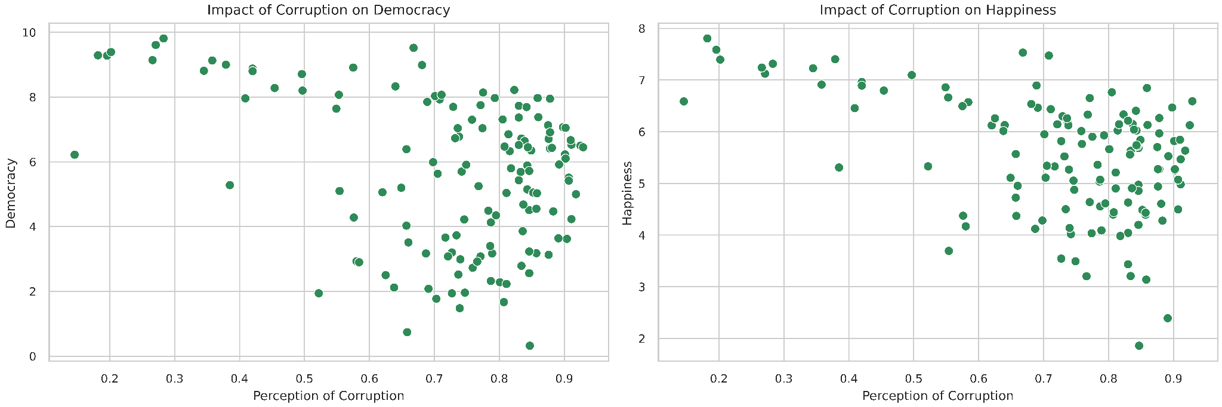
Democracy- A better Alternative
Perception of corruption
Perception of corruption
Democracy vs Corruption/ Happiness vs Corruption behave similarly
Indicates a close relationship between democracy and happiness and more revealing insights from democracy index than corruption

Slide 8
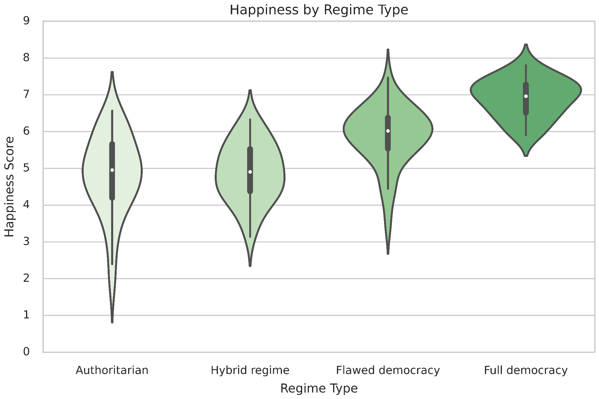
Impact of Regime Type
High levels of democracy closely predict a higher level of happiness
Low levels of democracy are not a strong predictor of happiness
Large disparity
Authoritarian Flawed Democracy
Hybrid Regime Full Democracy

Slide 9
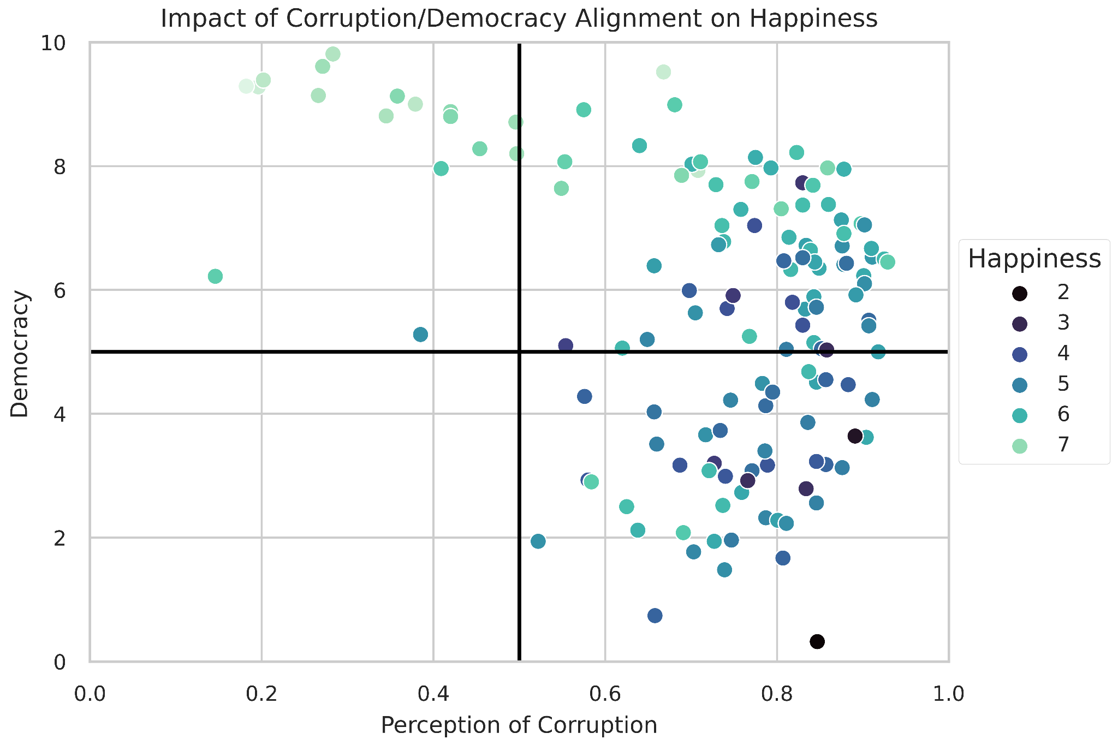
Corruption & Democracy
High Democracy,
High Corruption
Countries with high democracy and low corruption tend to be happier
High Democracy, Low Corruption
Countries with high democracy and high corruption have a greater disparity of happiness levels
Countries with low democracy and low corruption mostly have middle and lower levels of happiness
Low Democracy,
High Corruption

Slide 10
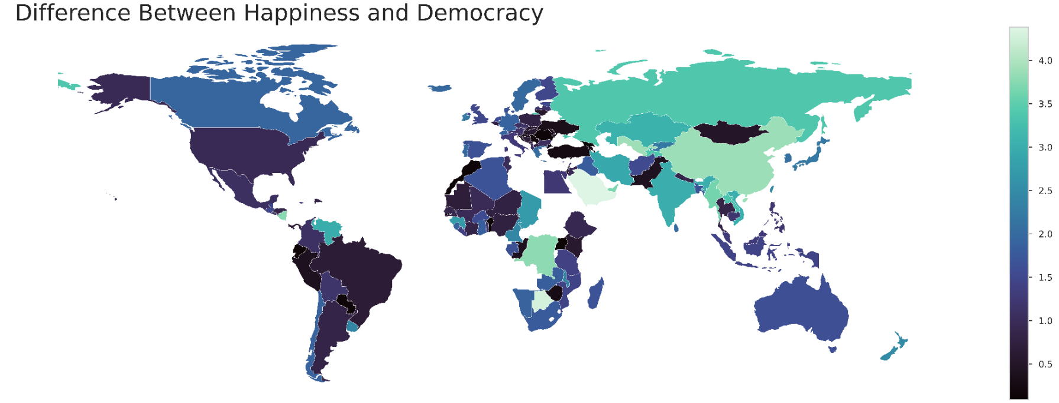
Happiness & Democracy - Discrepancies
Larger Difference between Happiness and Democracy
Similar Levels of Happiness and Democracy
Countries with the biggest differences between Happiness and Democracy:
1. Saudi Arabia 2. Botswana 3. Uzbekistan
4. China 5. Dem. Rep. Congo 6. Nicaragua

Slide 11
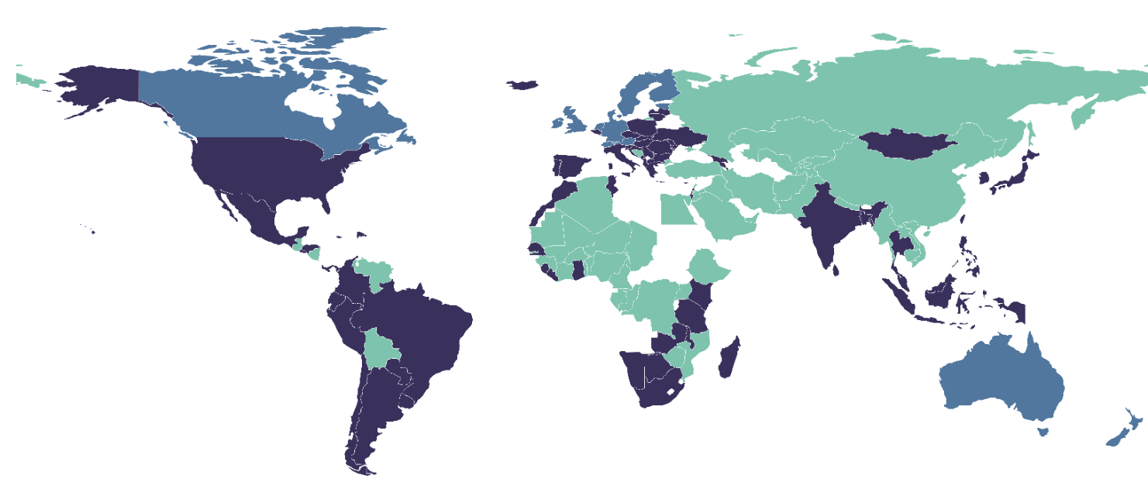
Democracy & Corruption Alignment
 | Low Democracy High Corruption
 | High Democracy Low Corruption
 | High Democracy High Corruption
Many of the countries with a larger difference between happiness and democracy have a low level of democracy and high levels of corruption
China, Venezuela, Russia,
DR Congo, Nicaragua, Uzbekistan

Slide 12
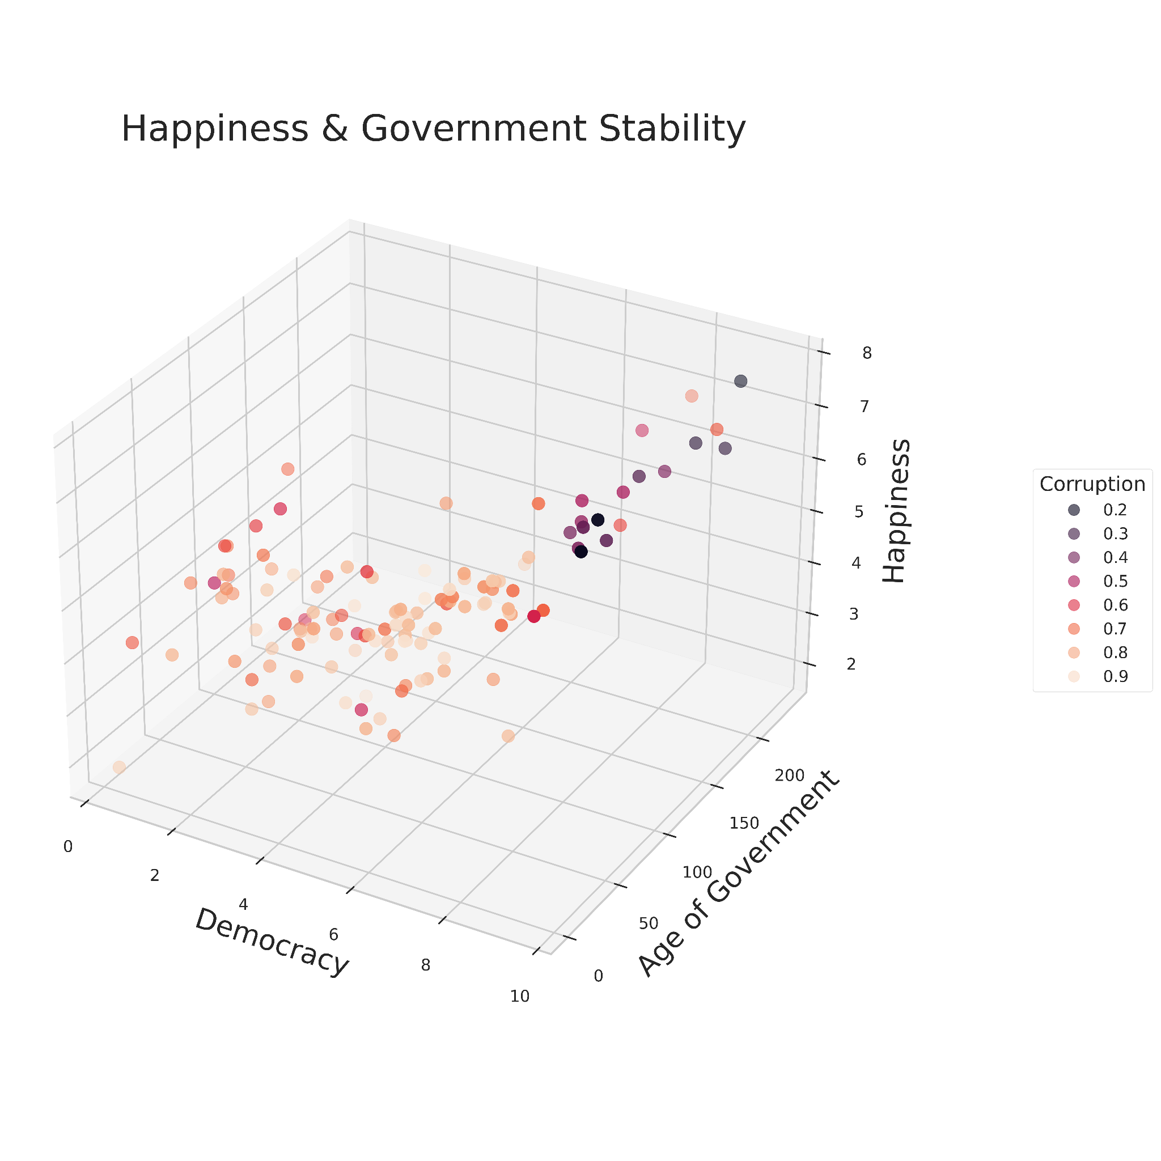
Additional factors
Older, more democratic nations tend toward greater likelihood of happiness
Higher correlation with happiness and democracy than happiness and age
Clear relationship between democracy and perception of corruption
High variance in perception of corruption at low democracy

Slide 13
03
Conclusions

Slide 14
Overall Findings
Perception of corruption is a poor indicator of happiness
And varies widely among less democratic nations
Democracy is a strong indicator of happiness for more democratic nations
But a poor indicator for less democratic nations
Democracy is a stronger indicator of happiness than age of government or perception of corruption
Overall, more stable (older, less corrupt countries) and more democratic countries are happier

Slide 15
questions?

